Slide 1

Railroad Block Signal
Railroad Block Signal Software Tool
Team Members:
Kenneth Truex
Chad Mason
Zachary McHenry
Christopher Diebold

Slide 2
Goals
To design and implement a tool with a rich GUI that can be used to automate the layout of electronic devices on a given length and topology of train track.
Cross platform GUI
Parse input track topology information from GE databases
Develop an algorithm to determine the optimal layout of electronics along a given length of track (Optimization variable will be the total cost of electronics)
Run sample track setups with pre-defined best-case scenarios to ensure that the tool provides the optimal layout.

Slide 3
Motivation
Save money by reducing the number of electronics needed
Save time. The experts can now use their time elsewhere
Project has been attempted several times by other teams with no success
America has the world’s most advanced railroad system, so we would get to work on state of the art technology
Ability to decrease the risk of a fatality, through the layout of electronics improving track safety

Slide 4
Technical Challenges
The following items are things that our team members have little or no experience with and so, would prove very large technical challenges:
Working with multiple extremely large databases
Determining an algorithm to be used for track layout optimization and which modifications need to be made.
Determining proof of correctness of the track layout.
Working with a requirements document
Using agile development methodology
Managing a project of this scale

Slide 5
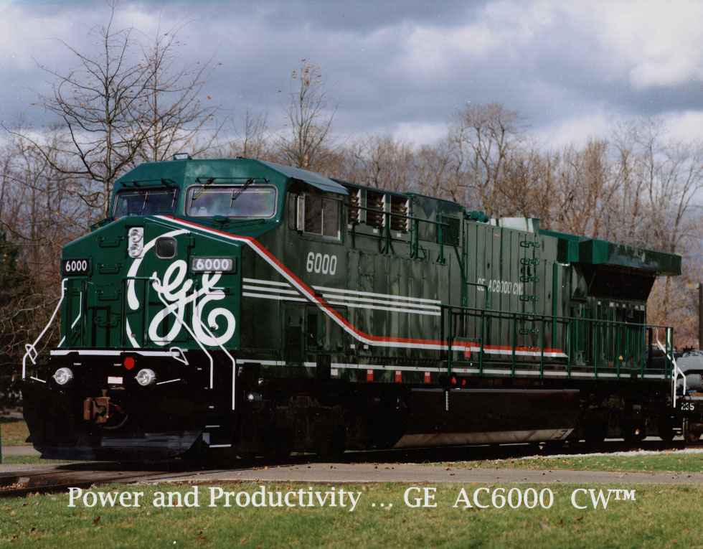
Milestones

Slide 6
Milestone 1
Obtain requirement document from GE
Decide on IDE/Programming Language/Database tools
Evaluate selected tools with small examples to analyze
integration/cohesiveness of tools
Begin drafting design of the program and GUI

Slide 7
Milestone 2
Parsing the database
Do a GUI mockup and present to GE

Slide 8
Milestone 3
Finalize approved GUI
Finish choosing algorithm
Begin modifying algorithm to fit with the project

Slide 9
Milestone 1 Role Distribution
Task | Chad | Ken | Chris | Zach
Obtain requirement document from GE | 25% | 25% | 25% | 25%
Evaluate selected tools with small examples to analyze integration/cohesiveness of tools. | 25% | 25% | 25% | 25%
Begin drafting design of the program and GUI | 25% | 25% | 25% | 25%
Decide on IDE/Programming Language/Database tools | 25% | 25% | 25% | 25%

Slide 10
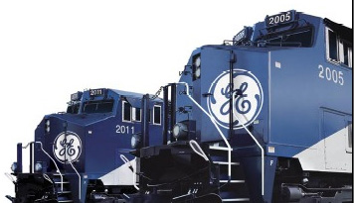
Any Questions?

